Slide 1
Secure Test Serverless Online Test

Slide 2
Description
A software company recruiting 100 students in campus recruitment ,so they are facing challenges:
Initial screening of 1000+ candidates, Testing their skills ,Preventing impersonation ,Standardizing evaluation based on the above scenarios we have to create a online test by using aws services to solve these issues.
S3 Bucket: Secure storage for test content and questions
Lambda Functions: Serverless computing for authentication and test evaluation
RDS Database: Reliable storage for user data and test results
Custom Authentication: Email-based unique access control
Solution :
24/7 exam availability Global accessibility ,Instant Result ,Reduced certification costs by 60%

Slide 3
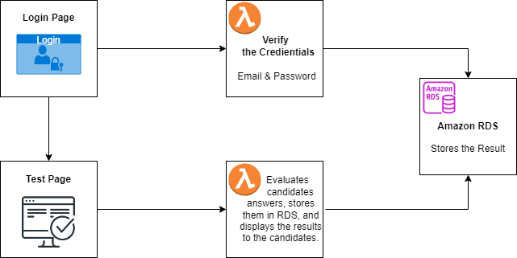
Flowchart of Project

Slide 4
Services used for Project
1.AWS Lambda
1.Triggers
2.Cloud Watch Logs
2.S3 (Simple Storage Service)
1.Bucket
3.AWS RDS
1.Database
2.CloudWatch Metrics ,Logs & Events
4.Dbeaver(To Display data in RDS)

Slide 5
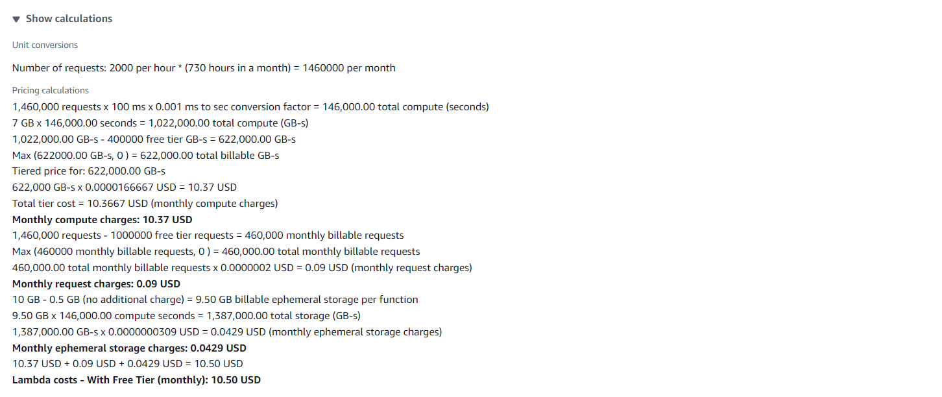
Pricing - AWS Lambda

Slide 6
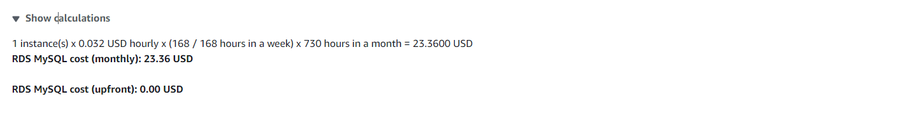
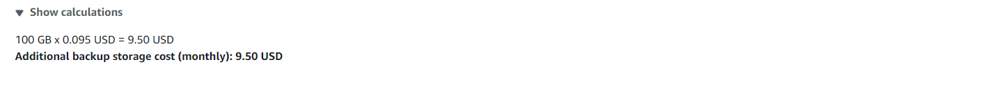
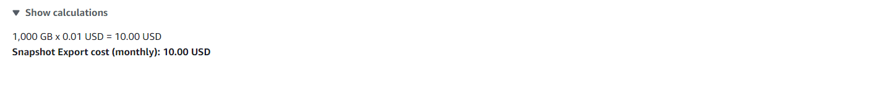
Pricing - AWS RDS

Slide 7
1.Sign-in to AWS Root Account
1.Search for AWS Management Console in Browser.
2.Open to the AWS Management Console.
3.Click on “Sign In to the Console”.
4.Choose “Root user” as the login method.
5.Enter Email and Password that is associated with your AWS root account.
6.Click on Sign in.

Slide 8
2.SettingUp Lambda
1.Search for Lambda in Search bar and open Lambda dashboard.
2.Click on Create Lambda Function , Assign a Name to Lambda & Runtime(Language) , Select Architecture as x86_64 , Click on Create a new role with basic lambda Permissions , Create.
3.Click on Add Trigger , Search for API Gateway , in intent block - checkmark on Create new API , in API type block select REST API , in Security dropdown select Open and Add it.
4.Click on Code in Lambda Function , Click on Upload from , select the ZIP file ,click on “Upload to” Upload the zip file in Lambda function & the code will be Deployed if not Click on Deploy.
5.Click on Configuration in Lambda Function to get API Endpoint & Copy it.
6.Open VScode, Paste the API Endpoint in JavaScript code , Open the website ,enter the data that has to send to Lambda & , Click on the button to Hit a request to Lambda Via API Gateway from website.

Slide 9
7.Click on Monitor in Lambda Function ,Click on view Cloud Watch Logs & Open Log groups – “aws/lambda/lambda_name” to watch the logs of the created Lambda Function.
8.We can see the logs of Hitting Request to Lambda via API Gateway from Website of Local Host.
9.When we hit a request from Website to lambda through API Gateway’ end point then API Gateway will receive a request from Website with data & that came in raw body to Lambda Function.

Slide 10
2.1 SettingUp Testlogin Lambda
Use of Testlogin Lambda:
1.It is used to take the data of Testlogin page from website to AWS Lambda.
2.If any data is missed it returns missing data field.
3.It Takes email & password, when login button is clicked , it sends the data to AWS lambda & then lambda connects to RDS.
4.If email does not match in database then it returns Invalid Email.
5.If password doesn’t match in database for Corresponding email then it returns Invalid Password.
6.If both email & password are wrong then it returns Invalid Credentials.
7.In RDS ,it Checks if the email exists in database or not, if exists then checks the corresponding password, if both matches it is directed to Start test page.

Slide 11
2.2 SettingUp Testevaluation Lambda
Use of Testevaluation Lambda:
1.It is used to take the data of test page from website to AWS Lambda.
2.When the options are selected for the given question by clicking on radio button ,All the selected option of the questions are stored in an selected_options array.
3.It Takes data of email ,password, selected_options , send to AWS lambda when submit button is clicked, the lambda code starts executing.
4.Lambda contains the array of correct answers in it, when these selected_options are sent it evaluates the answers of the Candidate and Calculate Score, Percentage, Pass_Fail_Message that shows candidate is pass or Fail and detail summary of evaluation of all the data in RDS.
5. When the test is submitted, it shows 'Result Stored Successfully' along with the student's result, and all the data is added to RDS. .
6. If a candidate tries to submit again, it won't be possible, and 'Test already submitted' will be displayed.

Slide 12
3.SettingUp S3 for Hosting
1.Search for S3 in Search bar and open S3 dashboard, Click on Create Bucket.
2.Select the bucket type as General Purpose, Give Unique bucket name to your bucket.
3.Checkmark on Block All public Access, Select ACL’s disable in Object Ownership & Click on Create Bucket.
4. Select the S3 Bucket ,Click on Objects ,Click on Upload & Choose the files from your PC.
5.Click on file to be uploaded (Html CSS JS) and Click on Upload.
6.When we use the Object URL of this file in S3 bucket it will be only available for your Private users.
7.If the Public Users wants to access the website.
8.Select the file in S3 bucket ,Click on permissions, Uncheck mark the “Block all public access” to convert into Public ,Copy the Bucket ARN number & Click on Edit on Bucket Policy.

Slide 13
9.Select S3 bucket policy in Select Policy type ,Click on Allow Effects & Type * in Principles.
10.Check mark All Actions , Paste the Bucket ARN and enter /* after Bucket ARN.
11.Click On Add Statement & Click on Generate Policy.
12.Copy the code from AWS Policy and Paste it in Bucket Policy & Save it.
13.Bucket Policy edited Successfully.
14. Now public users can access our website by Object URL.

Slide 14
4.Setting Up RDS
1.Search for RDS in Search bar and open RDS dashboard, Click on Dashboard.
2.Click on Create Dashboard ,Select Standard Create in Choose Database Creation Method & Select Engine of database.
3.Select Free Tier in Templates , Give Name to database, Create Username & Create Master Password for database in Credential Settings.
4.Select the Instance type, Storage & Select default VPC ,Checkmark Yes in Public Access.
5.Select default Security Group & Choose Availability Zone.
6.Enable Enhance Monitoring In Monitoring & Click on Create.
7.Database is created , Open database , Click on Connectivity & Security.
8.Click on VPC Security groups, Click on default group ,it will direct us to Security group details.
9.Click on Inbound rules , Click on edit Inbound rules & Click add rules – Select Custom TCP with port number 3306(Database port number) & Click on save.
10.Copy the Endpoint of the Database. (Paste it in Lambda & Dbeaver).

Slide 15
5.DBeaver
1.Install DBeaver & Open.
2.Click on connect to database logo, Search for our Database Engine & Click Next.
3.Paste the Database Endpoint URL in Server Host, Enter the Username, Password & Click on Test Connection.
4.Click on OK & then Finish to Established Connection between RDS Database & Dbeaver.
5.Expand Database-1,Right Click on New Database & Enter Database name Click on OK.
6.Expand data1,Right click on it ,Select SQL editor & Open SQL Script.
7.To create a table in “testdata” database , copy the query1 in the script.
8.Run the SQL query , Table has been created & Expand the table in formdata1 database.
9.To insert the candidate login credentials ,copy query 2
10.To display the table Copy the query3 in the Script & Run the query then table is displayed.

Slide 16
Query-1
CREATE TABLE exam_results (
email VARCHAR(255) PRIMARY KEY,
password VARCHAR(255) NOT NULL);
Query -2
INSERT INTO exam_results (email, password) VALUES(
'student1@example.com','password123'),('student2@example.com','password234'),
('student3@example.com','password345'),('student4@example.com','password456'),
('student5@example.com','password567'),('student6@example.com','password678'),
('student7@example.com','password789'),('student8@example.com','password890'),
('student9@example.com', 'password901'),('student10@example.com', 'password012');
Query -3
SELECT * FROM exam_results;
These queries are used to create a table, that stores the email , password in “exam_results” table in “testdata” database in RDS.

Slide 17
Query -4
CREATE TABLE exam_testresults (
email VARCHAR(255) PRIMARY KEY,
password VARCHAR(255) NOT NULL,
totalMarks INT NOT NULL,
score DECIMAL(5, 2) NOT NULL,
percentage DECIMAL(5, 2) NOT NULL,
passFailMessage VARCHAR(100),
details TEXT);
Query -5
SELECT * FROM exam_results;
These queries are used to create a table, that stores the result in “exam_testresults” table in “testdata” database in RDS.

Slide 18
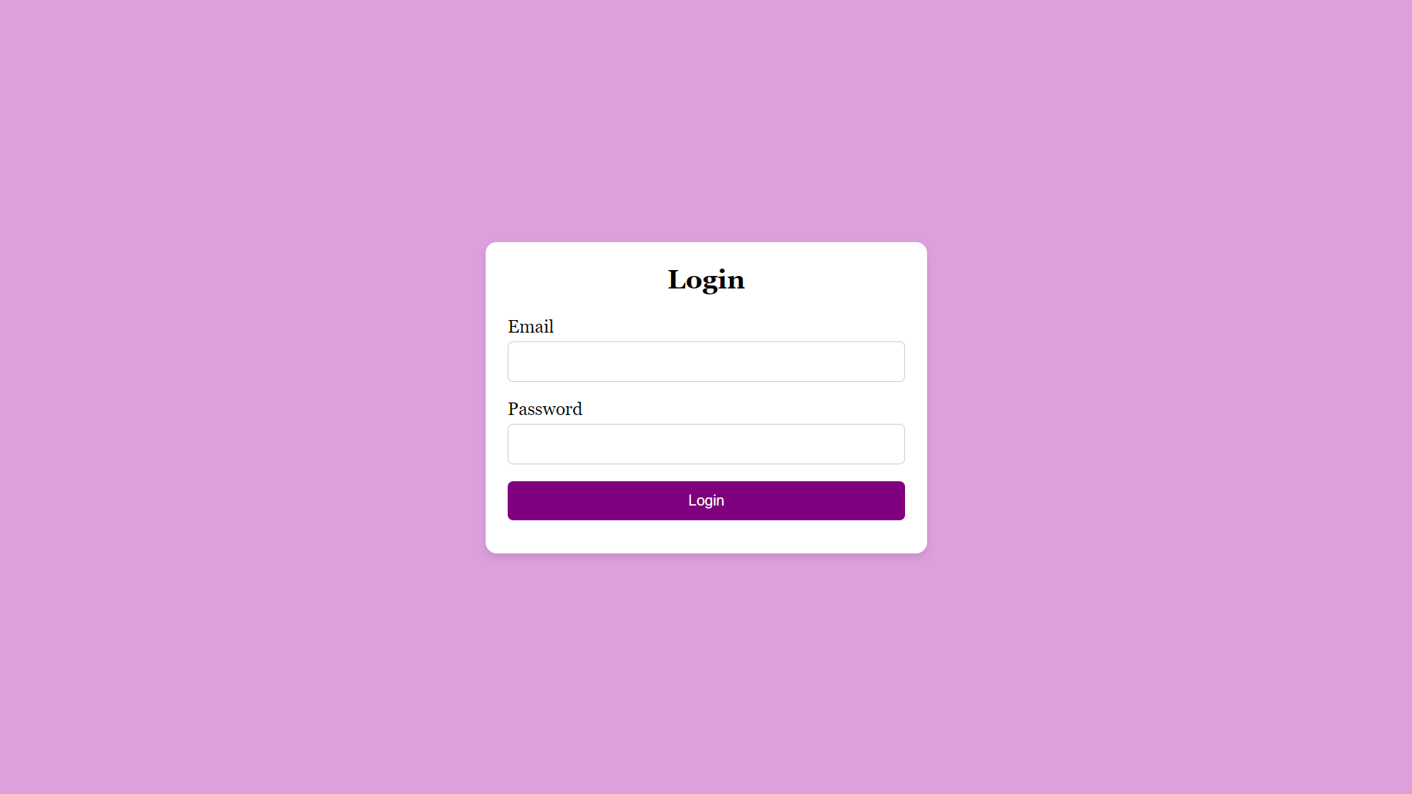
6. Working of Website- Login page.

Slide 19
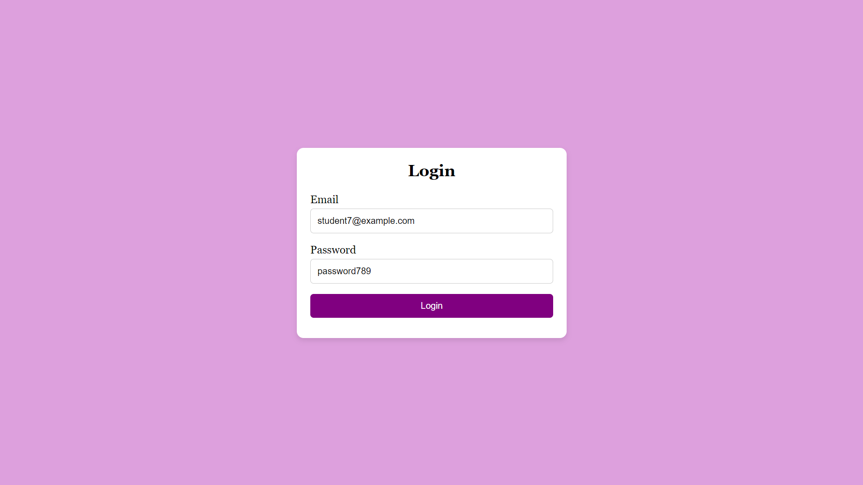
6.1 Login Details

Slide 20
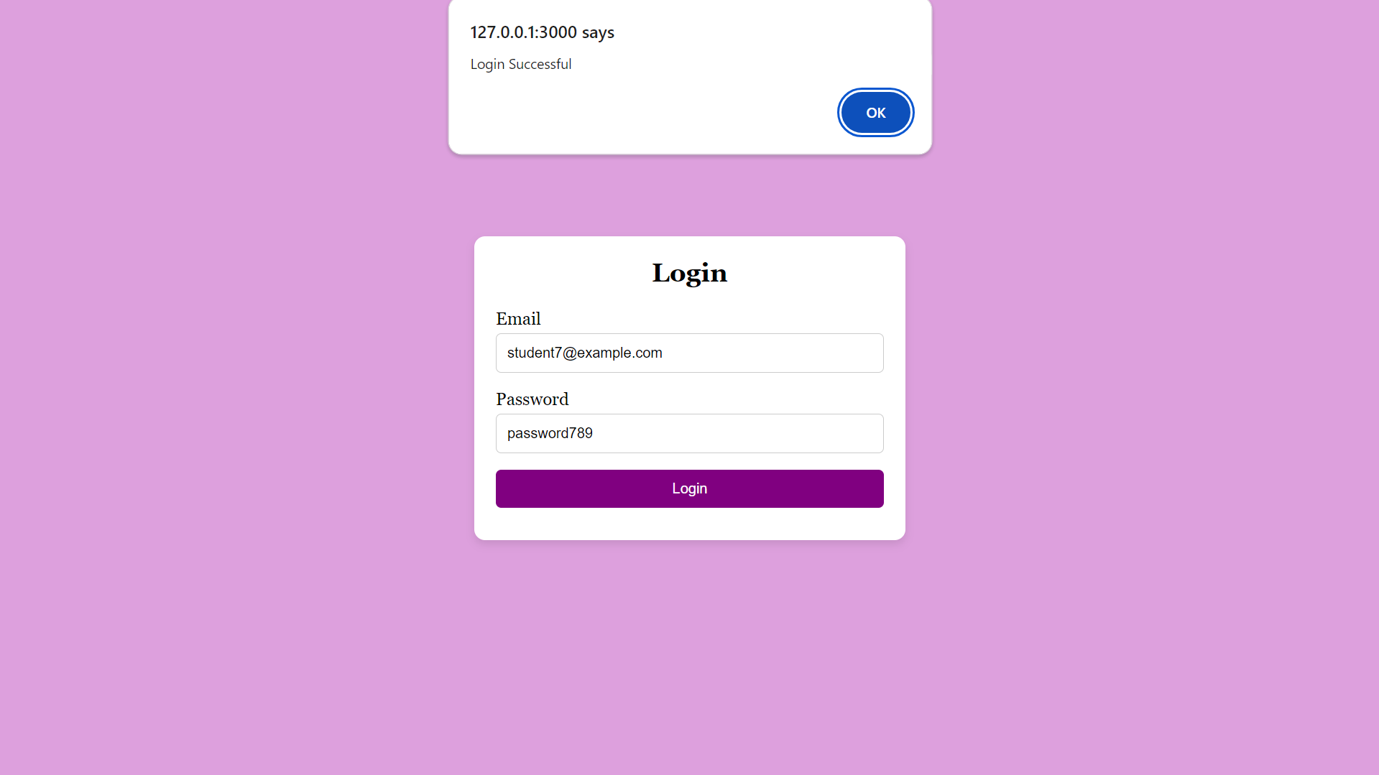
6.2 Login Successful

Slide 21
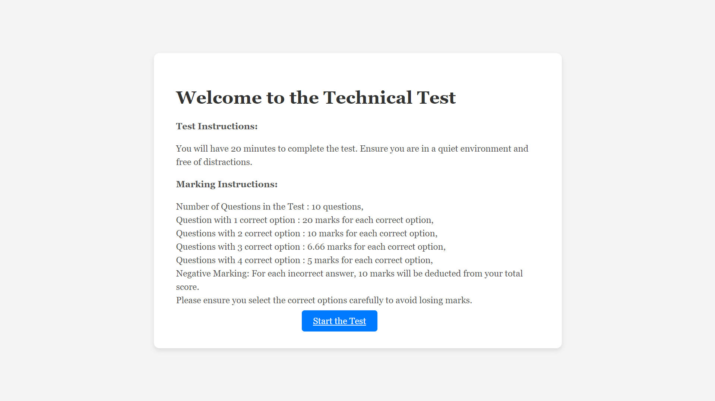
6.3 Click on Start the Test for exam

Slide 22
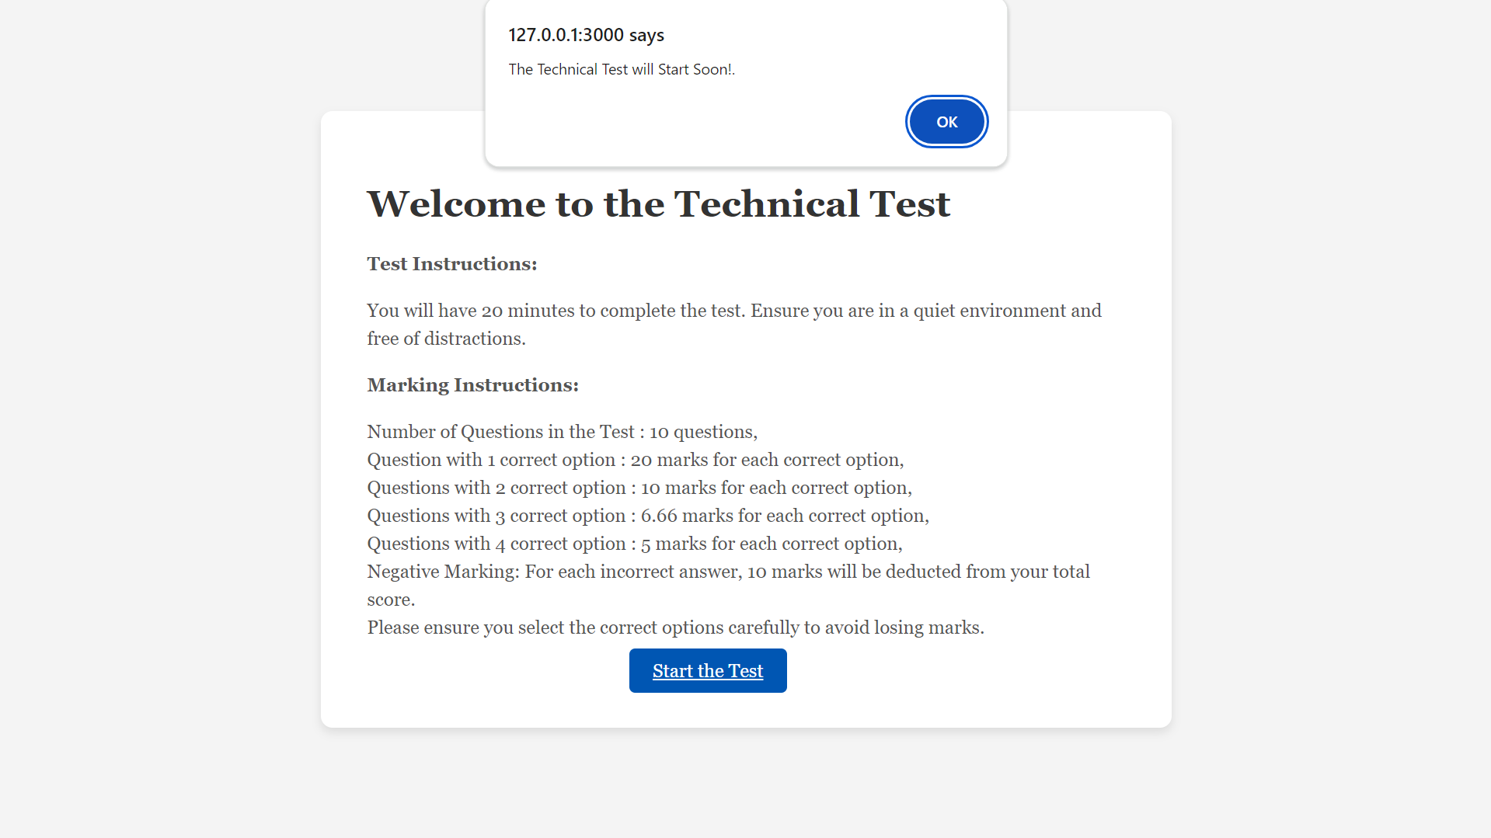
6.4 Click on OK

Slide 23
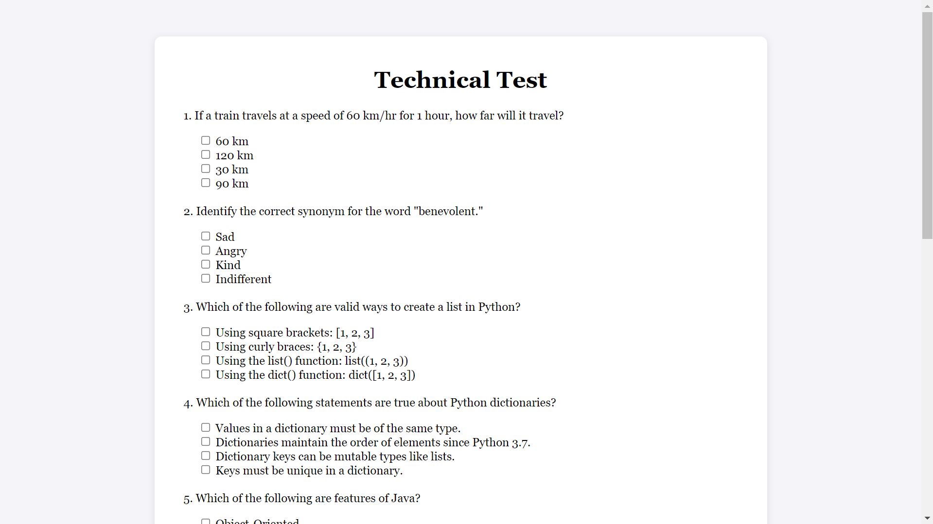
6.5 Start the Technical Test

Slide 24
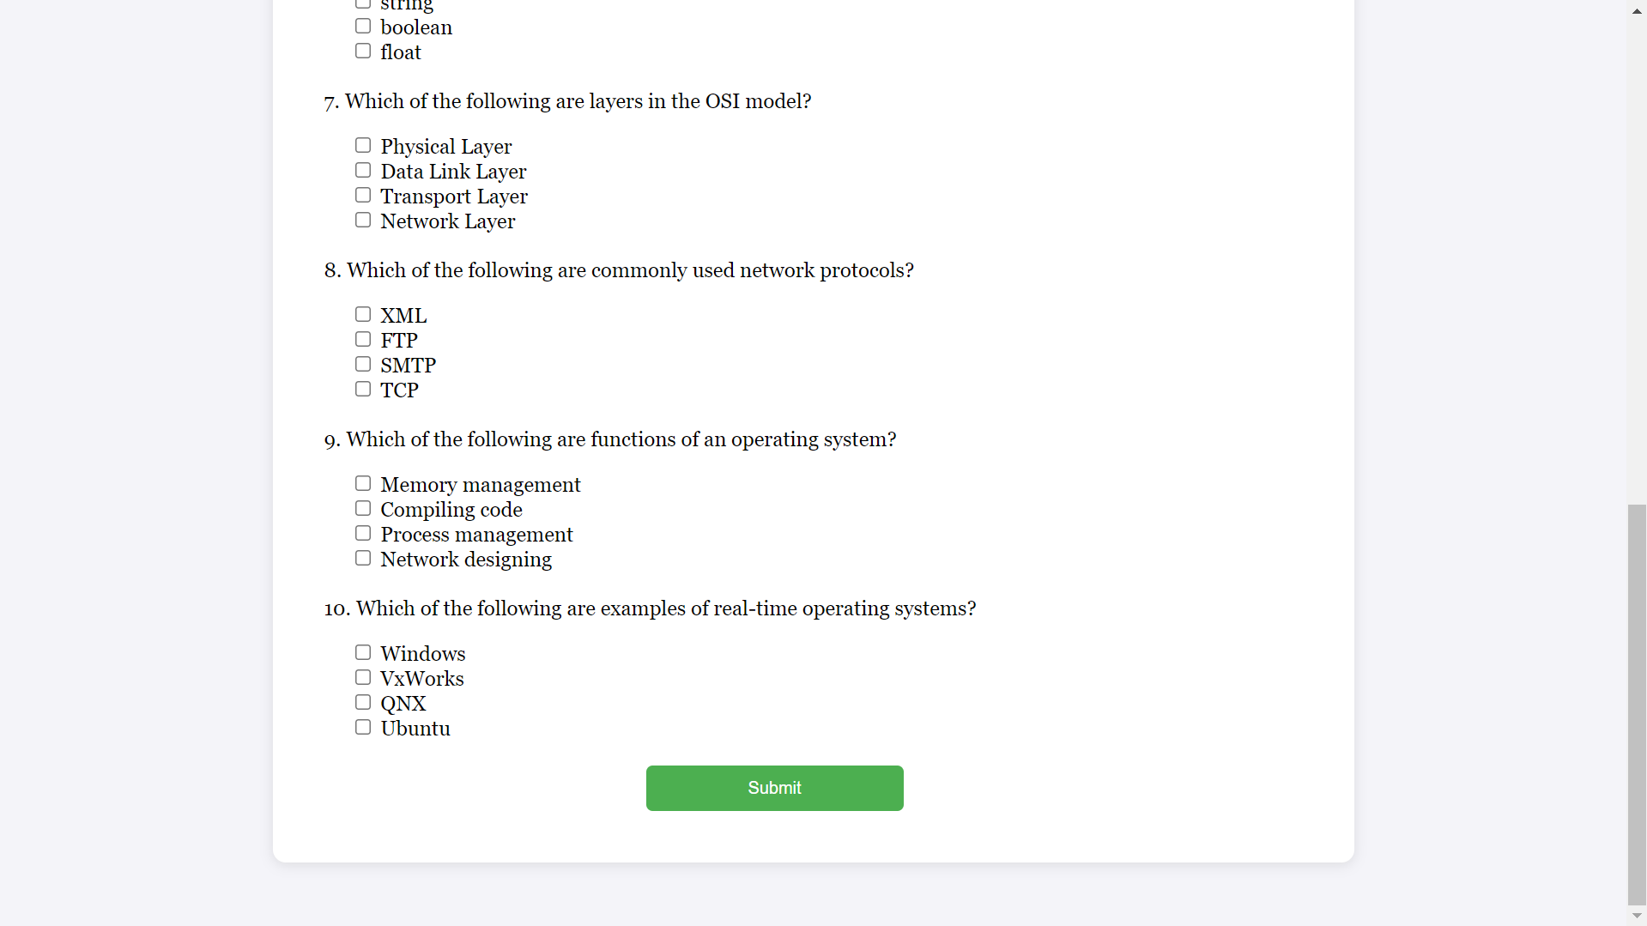
6.6 After test ,Click on Submit button

Slide 25
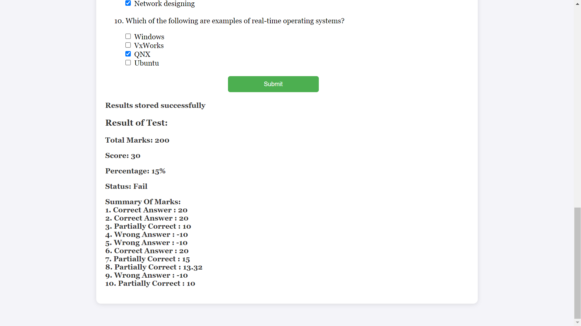
6.7 Result after the test

Slide 26
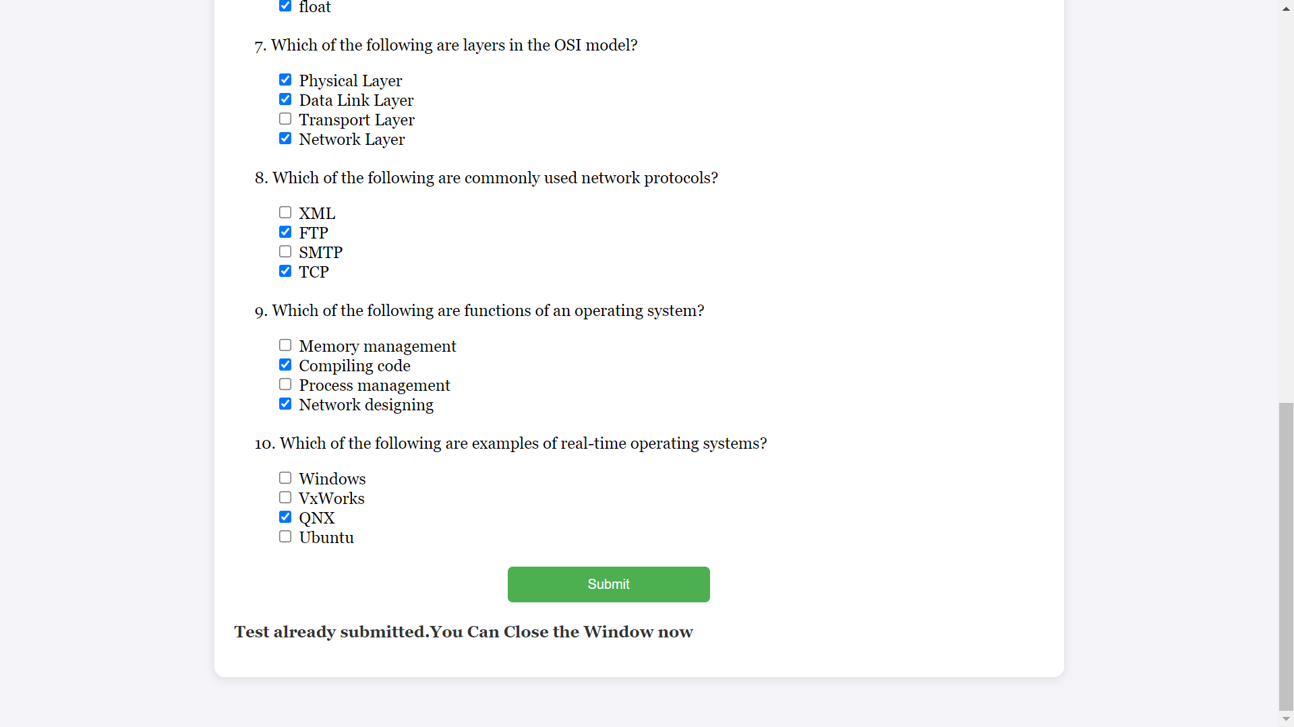
6.8 If candidate try to submit again.

Slide 27
7.Monitoring
1.Monitoring Lambda Function
1. Cloud Watch Logs for Lambda.
2. Detailed information of Request from Website to RDS.
3. Some logs of Website taking Data Successfully.
4. Cloud Watch Metrics
2.Monitoring Database
1. RDS Logs & Events.
2. Cloud Watch Metrics of RDS.
3. Maintenance , Backup & Snapshots in RDS.

Slide 28
Features Compared to Present Market Online Test Systems
Feature | SecureTest | Traditional Systems
Submission Control | One-time submission enforcement through email verification | Multiple submission possible with different accounts
Infrastructure | Serverless architecture with automatic scaling | Fixed server infrastructure
Cost | Pay-per-use model | Fixed monthly/yearly costs
Maintenance | Minimal maintenance required | Regular server maintenance needed
Security | AWS-grade security with S3 and RDS | Varies by implementation
Scalability | Automatic scaling with Lambda | Manual scaling required
Result Processing | Real-time evaluation | Often batch processing
Access Control | Email-based unique authentication | Username/password based

Slide 29
Conclusion
SecureTest represents a significant advancement in online testing systems, particularly in terms of security and submission control. Its serverless architecture on AWS provides a scalable, cost-effective solution that addresses the core challenges of online assessments.
Future enhancements could include:
AI-powered proctoring
Advanced analytics dashboard
Mobile application support
Integration with learning management systems
Extended support for multimedia question types
This system demonstrates how modern cloud technologies can be leveraged to create secure, efficient, and reliable testing solutions that meet the evolving needs of educational and professional assessment requirements.

